Slide 1
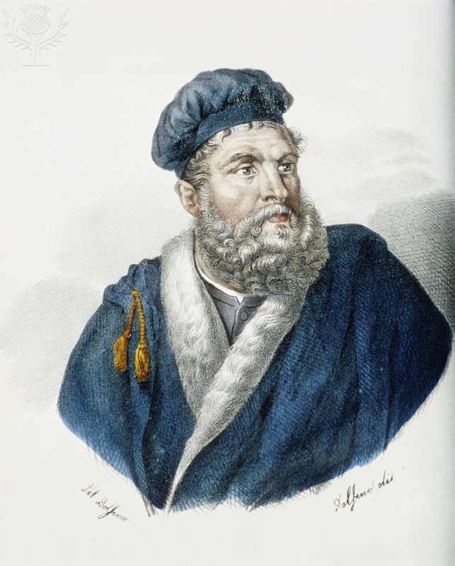
Marco Polo
By Brian Colgan This painting is of Marco Polo

Slide 2
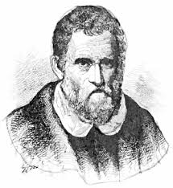
Early Life
Marco Polo was born on 1254 in Venice Italy
His father was Niccolo Polo who was an explorer and a jewel merchant
His uncle was Maffeo Polo who was an explorer too and was also a jewel merchant
Marco’s wife was Donata Polo and they had three children Bellela, Fantina, and Moretta Polo

Slide 3
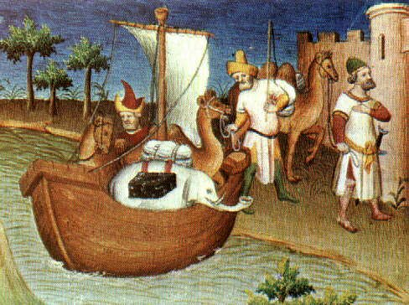
Travels to China
When Marco was only 17 years old his father and his uncle traveled to China
The trip lasted 3 years
They traveled to Khanbalik (Peking) where he stayed in the palace with the emperor and became one of the emperors closest friends
They left China in 1295 to return to Venice

Slide 4
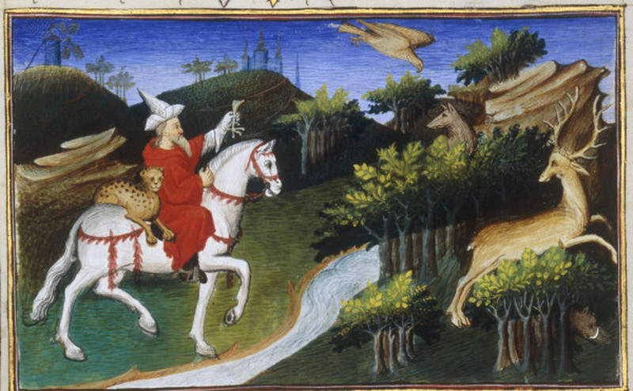
Travels to China (Continued)
While they were in China Marco made historic things such as – He was the first person to tell the Europeans about the richness and unusual sights in China
This was very important because it increased the trade between Europe and China and that then made them friends with each other
This is a painting of
Marco Polo exploring
In China

Slide 5
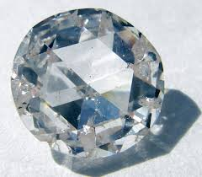
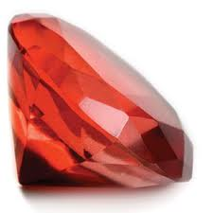
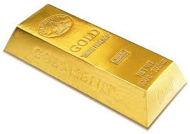
Why did Marco Traveled to China?
Marco Polo traveled to China for a couple of reasons
His father and his uncle convinced him to go after they had gone by themselves before
2. They were looking for good fortune like gold, diamonds, rubies, etc.

Slide 6
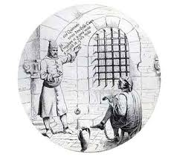
Under Arrest
On Marco’s way back from China he got captured by the Genoa
During his time in prison he dictated a book called The Travels of Marco Polo
Christopher Columbus picked up a copy of the book. The book made Columbus inspired to explore so he went out and discovered America
Marco finally got released out of prison in 1299 then returned back to Venice

Slide 7
Marco’s Death
Marco died of January 8th, 1324 due to an illness that he had and couldn’t be treated
He lived to be 70 years old
Marco was buried at the church of San Lorenzo in Venice Italy

Slide 8
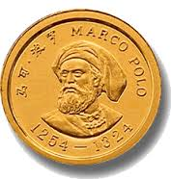
Marco’s Spirit Lives Today
Today you can see lots of items that was made for Marco
There are statues of him, Coins of him, Lots of paintings of him, and even T-shirts with him on it
Polo was a great explorer ad his spirit will live on forever

